Slide 1

Trust in data visualization
Iryna Kalynychenko
Psyc6135
June 17, 2021

Slide 2
Objectives
Trust and mistrust in information visualization
Role of risk
Visual Analytics: Trust as visualization of uncertainty
(Mis)Trust in InfoVis = Trustworthiness of InfoVis + Trust Perception of User
Trustworthiness of information and visualization
What influences user’s trust perception
Trust calibration process
Take-home messages

Slide 3
Trust in interpersonal relationships
“the willingness of a party to be vulnerable to the actions of another party based on the expectation that the other will perform a particular action important to the trustor, irrespective of the ability to monitor or control that other party” (Mayer, Davis and Schoorman, 1995, p.712)
Notes:
Marsh and Dibben (2003) in their article on The Role of Trust in Information Science and Technology elaborate on the complexity of the phenomenon of trust in social sciences and rely on Mayer et al. (1995) elaborate definition of trust in that “trust concerns a positive expectation regarding the behavior of somebody or something in a situation that entails risk to the trusting party.” (p.470)

Slide 4

Trust in information visualization
“the user’s implicit or explicit tendency to rely on a visualization and to build on the information displayed” (Mayr et al., 2019, p.25)

Slide 5

Mistrust
Placement of trust into information visualization, where it turns out to be not justified, due to the information being outdated, represented in a misleading way, or because the designer purposefully wanted to disinform or mislead the users.
Marsh and Dibben (2005)
Notes:
Mistrust is the placement of trust into an information, where it turns out to be not justified, due to the information being outdated, represented in a misleading way, or because the designer purposefully wanted to disinform or mislead the users (Marsh and Dibben, 2005).

Slide 6
Risk
“trust is required to reduce the uncertainty associated with digital information, especially if the trustor is vulnerable to suffer some kind of loss if he or she relies on it (e.g. taking a wrong decision, humiliation by others), but also depends on the information” (Kelton et al., 2008, p.365)
Notes:
The issue of trust becomes relevant when there is some kind of risk associated with the use of information visualization.

Slide 7
Trust in the context of visual analytics
Conceptualized in relation to visualization of uncertainty
Types of uncertainty: Data source & Data model
Multiple aspects of uncertainty:
completeness,
consistency,
lineage,
currency,
credibility,
subjectivity,
interrelatedness
Mayr et al. (2019), MacEachren et al. (2012), Sacha et al. (2016)
Notes:
Visual analytics is essentially generating knowledge from large and often complex datasets. The user arrives at new knowledge after performing numerous sensemaking activities. To succeed in the process of new knowledge generation, end users need to be able to trust their knowledge generated by means of visual analytics. (Sacha et al., 2016)
In the context of visual analytics, trust has been conceptualized in relation to visualization of uncertainty.

Slide 8
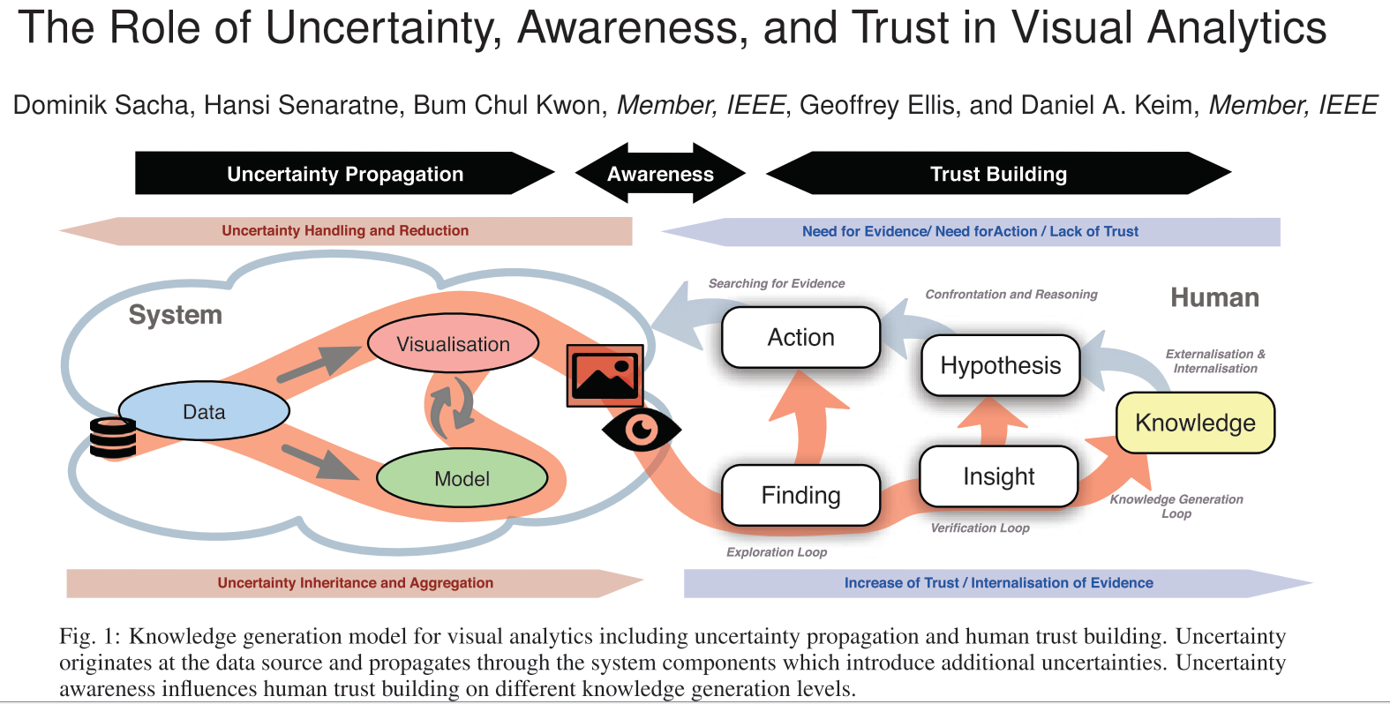
Notes:
Sacha et al., 2016 presented a trust model in which the visualization acts as mediator between uncertainty propagation and trust building. Trust is increased when the users are informed about the presence of uncertainty in the data. However, the link between the visualization of uncertainty and trust was not studied empirically. Moreover, in some cases, visualization of uncertainty may increase distrust (Mayr et al., 2019). Even data analysts cope differently with uncertainty—from ignorance to minimizing, understanding and exploitation (Boukhelifa et al., 2017).

Slide 9
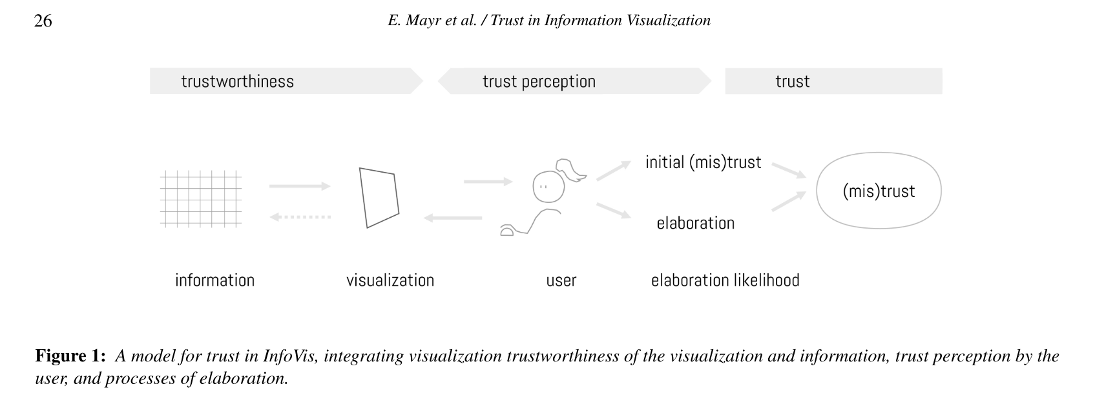
situational – adjusted in response to situational cues, and dynamic (Marsh and Dibben, 2005)
established online, changes and evolves during user interaction with the InfoVis (Mayr et al., 2019)
Trust in InfoVis is:
Notes:
As trust is a two-sided (i.e. a referential) construct, we have to understand both sides: the side of the trustor—the user—and the side of the trustee—in our context the information visualization (see figure 1). Trustworthiness refers to the properties of the visualization (and the underlying data) that lead users to trust it. Trust perception is the user’s subjective evaluation of the quality and reliability of the visualized information.
Many different processes can lead a user to put trust in an information visualization. Which one is chosen depends on the interaction with the InfoVis, because trust is a situative construct that changes and evolves over time. Figure 1 from the work of Mayr et al. (2019) brings together the basic factors from the visualization and the user side - and integrates the essential role that processes of elaboration play for trust.

Slide 10
Trustworthiness
"source dependability or the confidence the user has in the information“ (MacEachren et al., 2012,p. 2498)
Notes:
Trustworthiness of data visualization has rarely been studied.

Slide 11

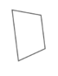
InfoVis trustworthiness
Information
Visualization
accuracy (free from error)
currency (up-to-date)
coverage (completeness)
objectivity (unbiasedness, availability of multiple perspectives)
validity
predictability
inclusion of all relevant information
transparency about the underlying data and designers’ decisions about data, representation and interaction (Dörk et al., 2013)
design factors like usability and user experience (e.g. positive look and feel) (Costante et al., 2011)
appropriate representation of uncertainty (debate)

Slide 12
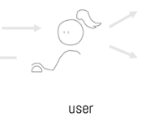
Trust perceptions
Studies:
Disposition to trust information and visualization
Personality traits (need for cognition vs emotion in information)
Context of use
Prior knowledge and attitudes on the topic
Intentions and perceived risk
Inconsistencies and lack of clarity within a visualization
Coherence within InfoVis, and between InfoVis and its title
Sprague and Tory (2012): Trust perception affects InfoVis use when the information is personally very relevant or a decision based on incorrect information would have a high cost.
Hullman et al. (2011): “Visual difficulties” activate critical thinking and stimulate user to scrutinize a visualization.
Kong et al. (2019): Misalignment of visualization and text affects understanding and credibility of information.
Notes:
Factors that influence trust perceptions

Slide 13
How we decide to put trust in an InfoVis:
A source is known and proved to be trustworthy in the past.
A source has a reputation of being trustworthy (e.g. based on good reviews, authority of the source, certification).
Personal identification with a source, as it conforms to one’s goals, knowledge, or values.
Emotional connection established due to the aesthetics and graphic design.
Carefully checking the reliability of the information, e.g. by using and comparing multiple sources.
Kelton et al. (2008)
Notes:
Information processing occurs through elaboration and evaluation of information. Different situative factors (time available, amount of risk involved) determine how deeply users elaborate the information to decide if it is trustworthy. In some cases, situational cues, like references to the source of information, is enough to establish trust to visualized information.

Slide 14

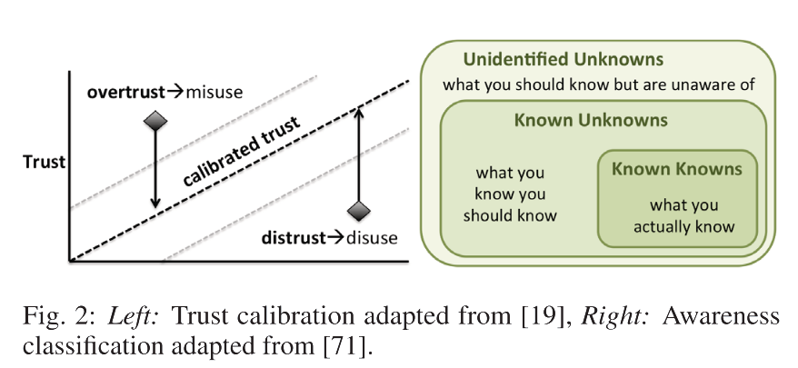
Sacha et al. (2016)
Notes:
Building on the works of Visser et al., 2014, and Skeels et al., 2010, Sacha et al. (2016) bring our attention to the aspect of calibrated trust and its effect on the use of the visualization, and the role of awareness in the process of user interaction with the visualization. Figure 2 from their paper illustrates trust calibration and the included uncertainty problems. A miscalibration between the humans’ trust and the systems’ trustworthiness leads to overtrust or distrust that are directly connected to disuse and misuse of automation.
Skeels et al. (2010) deliver a comprehensive perspective on uncertainties for information visualisation and also briefly discuss the role of awareness (Fig. 2 Right). They suggest that Unidentified Unknowns as the worst kind of missing information because in that case humans are building more trust than they should do.
Visser et al. (2014) provide a design taxonomy for trust cue calibration that includes all kinds of information that may influence human judgement.

Slide 15
Take-home messages
Many factors determine trustworthiness of an InfoVis, user perceptions and whether the InfoVis will evoke user trust and consequent use of the InfoVis
Remember that trust in information (systems, visualization, etc) is often situational and dynamic
When developing an InfoVis:
Reflect on the uncertainties in data and model
Keep your users in mind
Represent appropriate level of uncertainty

Slide 16
References
Costante, E., Den Hartog, J., Petkovic, M. (2011). On-line trust perception: What really matters. In 2011 1st Workshop on Socio-Technical Aspects in Security and Trust (STAST), IEEE, pp. 52– 59.
Dörk, M., Feng, P., Collins, C., Carpendale, S. (2013). Critical infovis: exploring the politics of visualization. In CHI’13 Ex- tended Abstracts on Human Factors in Computing Systems, ACM, pp. 2189–2198.
Hullman, J., Adar, E., Shah, P. (2011). Benefitting infovis with visual difficulties. IEEE Transactions on Visualization and Computer Graphics 17(12), 2213–2222
Kelton K., Fleischmann, K. R., Wallace, W. A. (2008). Trust in digital information. Journal of the American Society for Information Science and Technology 59(3), 363–374.
Kong, H., Liu, Z., Karahalios, K. (2019). Trust and recall of information across varying degrees of title-visualization misalignment. In CHI 2019.
MacEachren, A. M., Roth, R. E., O’Brien, J., Li, B., Swingley, D., Gahegan, M. (2012). Visual semiotics amp; uncertainty visualization: An empirical study. IEEE Transactions on Visualization and Computer Graphics 18, 2496–2505.

Slide 17
References
Marsh, S., Dibben, M. R. (2005). Trust, untrust, distrust and mistrust– an exploration of the dark(er) side. In International Conference on Trust Management, Springer, pp. 17–33
Mayer, R. C., Davis, J. H., & Schoorman, F. D. (1995). An Integrative Model Of Organizational Trust. Academy of Management Review, 20(3), 709–734. https://doi.org/10.5465/amr.1995.9508080335
Mayr, E., Hynek, N., Salisu, S., & Windhager, F. (2019). Trust in Information Visualization. EuroVis Workshop on Trustworthy Visualization (TrustVis). Eurographics Proceedings. https://doi.org/10.2312/trvis.20191187
Sacha, D., Senarantne, H., Kwon, B. C., Ellis, G., Keim, D. A. (2016). The role of uncertainty, awareness, and trust in visual analytics. IEEE transactions on visualization and computer graphics 22(1), 240–249.
Sprague, D., Tory, M. (2012). Exploring how and why people use visualizations in casual contexts: Modeling user goals and regulated motivations. Information Visualization 11(2), 106–123.

